Slide 1
Improved VPL Distribution
(Optimizing) Realistic Rendering with Many-Light Methods
(part of the “Handling difficult light paths” section)
Jaroslav Křivánek
Charles University in Prague
Notes:
In this part of the course, I will discuss various approaches for generating VPLs where they are most needed for a given camera view.

Slide 2
VPL rendering
Distribute VPLs
Render with VPLs
Notes:
Let me start by reviewing the classic many-lights rendering algorithm, Instant Radiosity.
In the first step, the VPLs are distributed on scene surfaces by tracing particles from light sources.
In the second step, the image is rendered by summing contributions from all the VPLs.
In this part of the course, I will focus on various approaches to distributing the VPLs.

Slide 3
Why alternate VPL distribution?
VPLs may not end up where needed
Notes:
The need to develop alternate VPL distribution approaches follow from the fact that with the basic VPL tracing algorithm, the VPLs may end up in regions where they do not contribute significantly to the image.

Slide 4
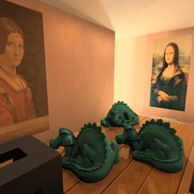
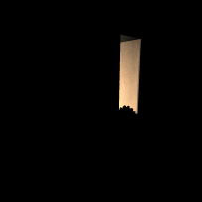
Example: Large environments
reference
scene
light source
inst. radiosity
camera
Images courtesy of Ben Segovia and Bernard Péroche
Notes:
This will be the case especially in large environments where the camera is looking at a small portion of the scene.
In the example shown here, the light source is far from the portion of the scene seen by the camera. The usual VPL tracing algorithm will generate many VPLs that do not contribute to the image at all.

Slide 5
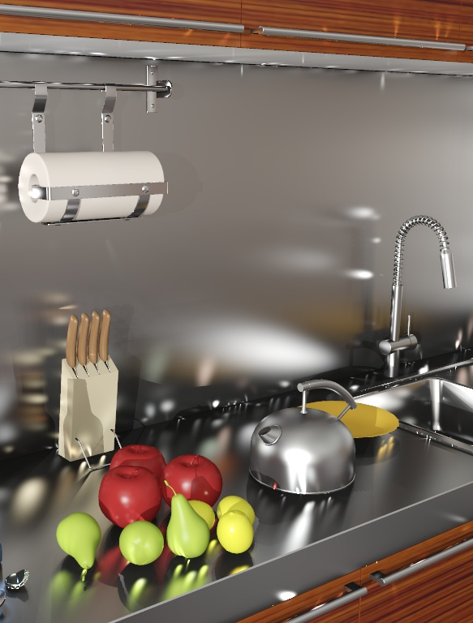
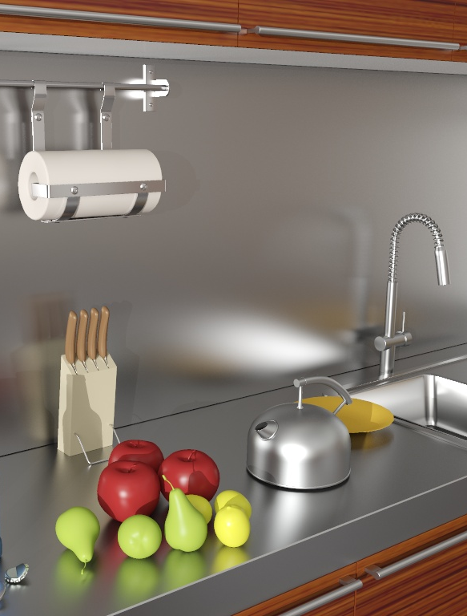
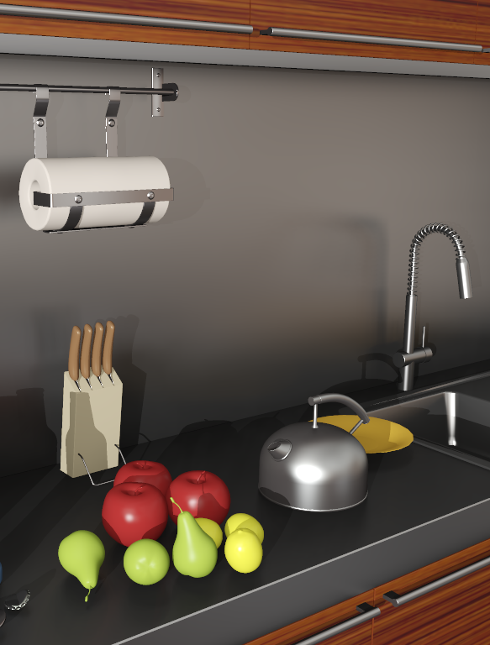
Example: Local light inter-reflections
instant radiosity
reference
clamping
artifacts
no local light inter-reflections
Notes:
In addition, VPL distributions generated by the basic VPL tracing algorithm cannot be used to render local light inter-reflections.
Here is an example. The number of VPLs along the edges is insufficient to render the local inter-reflections, resulting in artifacts in the form of light splotches.
The usual way of dealing with these artifacts the clamping that we discussed previously, where we clamp the contribution of a single VPL to a prescribed maximum value.
But this selective energy removal can severely change material appearance, as you can see in the image on the right.
A better solution would be to ensure that more VPLs are generated in the visible areas along the edges.

Slide 6
Purpose & approach
Purpose
Ensure VPLs end up where needed
Approaches
Rejection of unimportant VPLs
Metropolis sampling for VPL distribution
Distribute VPLs by tracing paths from the camera
Notes:
So, the goal is to get the VPLs where they are most needed. A number of approaches have proposed for this and I will discuss the following three in the remaining part of my presentation.
The simplest approach is to apply rejection sampling, where VPLs that do not significantly contribute to the image are rejected.
Second, we can use a more advanced sampling algorithm such as Metropolis sampling.
And finally, we can distribute the VPL by tracing paths from the camera instead of from light sources.

Slide 7
Rejection of unimportant VPLs

Slide 8
Rejection of unimportant VPLs
Autodesk 360 Rendering
Covered by Adam later in the course
[Georgiev et al., EG 2010]
Covered on the following slides (courtesy of Iliyan Georgiev)
Good for large environments but not for local interactions
Notes:
A form of rejection sampling is used for VPL distribution in the Autodesk 360 Rendering solution that will be later described by Adam Arbree.
So I will only briefly mention the approach presented by Georgiev et al. in their EG 2010 short paper.

Slide 9
VPL rejection – Idea
Accept VPLs proportionately to their total image contribution
Reject some of those that contribute less than average
✗
✗
✓
✓
✓
Notes:
The main idea is very simple:
They use the exact same VPL tracing algorithm as in Instant Radiosity but they probabilistically reject the VPLs if their image contribution is less than average.

Slide 10
VPL rejection – Idea
Accept VPLs proportionately to their total image contribution
Reject some of those that contribute less than average

Slide 11
VPL rejection – Algorithm
Want VPLs with equal image contribution Φ_{v}
For each VPL candidate i
Estimate total image contribution Φ_{i}
Accept w/ probability (divide energy of an accepted VPL by p_{i} )
Notes:
Our goal is to generate a number of VPLs, all having the same “average” total contribution to the image Phi_{v} .
The algorithm generates one VPL at a time. For each candidate VPL proposed by the original VPL tracing algorithm, the total image contribution of the VPL, Phi_{i} is estimated. Then the VPL is accepted with a probability given by the ratio of the actual VPL contribution to the target “average” contribution. If accepted, the VPL energy is boosted by dividing by the acceptance probability (Russian roulette in action).

Slide 12
Estimating image contribution
No need to be accurate
Estimating Φ_{v} (average VPL contribution)
Based on a few pilot VPLs
Estimating Φ_{i} (contribution of VPL candidate i )
Contribution to only a few image pixels
Notes:
How do we estimate the target “average” VPL contribution? A simple way to do it is to run a number of pilot VPLs and render a low-resolution image. Another possibility is to use information form the previous frame, if rendering an animation.
To estimate the image contribution of a candidate VPL, we simply render a “low-res” image by picking only a couple of pixels.
There’s no need to be very accurate: It’s no use to spend much time on estimating the VPL contributions because the algorithm will produce correct results no matter how accurately the VPL contribution is estimated.

Slide 13
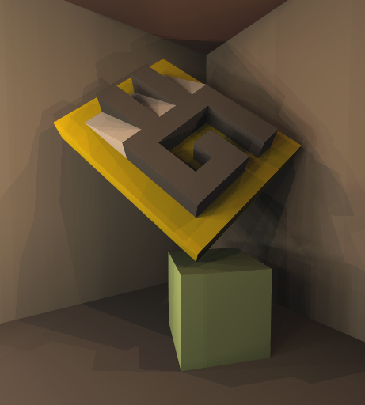
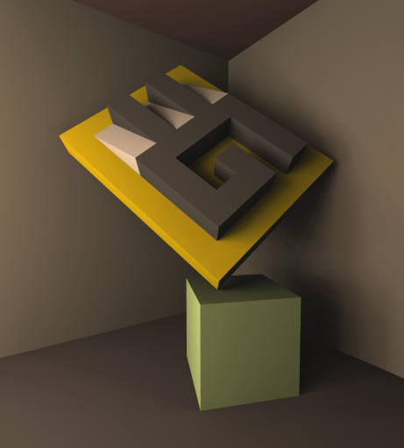
VPL rejection – Results
Instant Radiosity
[Georgiev et al. 2010] (7% acceptance)

Slide 14
VPL rejection – Conclusion
Cheap & simple
Can help a lot
“One-pixel image” assumption
Not suitable for local light inter-reflections
Notes:
To conclude, VPL rejection sampling is cheap and simple and can help a lot. There’s really no reason for not using it, especially in mostly diffuse scenes, unless one wants to apply a more advanced VPL distribution techniques.
The problem is that it makes the “one-pixel image” assumption – it will not help us to resolve the local inter-reflection problem.

Slide 15
Metropolis sampling for VPL distribution

Slide 16
Metropolis sampling for VPL distrib.
“Metropolis instant radiosity” [Segovia et al., EG 2007]
Good for large environments but not for local interactions
Notes:
Another approach, presented by Ben Segovia et Eurographics 2007, relies on Metropolis-Hastings sampling to distribute the VPLs.

Slide 17
Metropolis IR – Path mutation
light source
VPL = 2nd vertex from the camera
camera
Notes:
Given a light path that connects a light source to the camera, the 2nd vertex from the camera can be interpreted as a VPL (and stored and used for illuminating the scene when all other VPLs have been distributed).
Because the path connects the light to the camera, a VPL generated this way is very likely to have an important image contribution.

Slide 18
Metropolis IR – Path mutation
light source
VPL = 2nd vertex from the camera
camera
Notes:
We can now use the Metropolis-Hastings algorithm, as in Veach’s Metropolis Light Transport, to explore the space of all possible light paths by proposing local path mutations, as shown on the slide. Again, the 2nd vertex from the camera of the mutated path yields a VPL.

Slide 19
Metropolis IR – Path mutation
light source
VPL = 2nd vertex from the camera
camera
Notes:
In this way, we can keep on mutating the path and generating new VPLs.

Slide 20
Metropolis IR – Resulting VPL set
light source
camera
Notes:
All VPLs generated this way end up having important image contribution. In fact, it can be proven that they all contribute the exact same total power to the image.

Slide 21
Metropolis IR – Results
Instant Radiosity
Metropolis Instant Radiosity
Images courtesy of Ben Segovia and Bernard Péroche

Slide 22
VPL rejection vs. Metropolis IR
Same goal: VPLs with same image contribution
Similar VPL set quality
 | VPL rejection | Metropolis IR
Performance (not-so-complex cases)
Performance (difficult cases)
Implementation
✓
✓
✗
✓
✓
✗
Notes:
Though very different, both the Georgiev et al.’s VPL rejection algorithm and Metropolis Instant Radiosity will generate a set of VPLs where each VPL has roughly the same contribution to the image. From this, we can expect that the VPL set generated by both algorithms will be of similar quality.
Performance of VPL generation in reasonably complex scenes is likely to be similar for both algorithm. However, for very complex scenes, where light must bounce many times to reach the camera, the rejection algorithm will perform poorly because it will have to reject many VPLs.
On the other hand, the implementation of the rejection algorithm is trivial but MIR requires substantial implementation effort.

Slide 23
Sampling VPLs from the camera (Local VPLs)

Slide 24
Sampling VPLs from the camera
Address the local inter-reflection problem
Guaranteed to produce VPLs important for the image
Notes:
None of the two previously discussed approaches help with the problem of local light inter-reflection.
To deal with this problem, it is more reasonable to distribute the VPLs by tracing paths from the camera instead of from the light sources. This approach is bound to produce VPLs in locations important for the image to be rendered, but there are some important technical issues that need to be taken care of:
First, we need to explicitly connect these VPLs to the light sources so that they can form complete light transport paths.
Second, computing the VPL intensity involves the evaluation of the probability density of generating the particular VPL position. The probability calculation is significantly more complex (and costly) when the VPLs are generated from the camera.

Slide 25
Sampling VPLs from the camera
“Bidirectional instant radiosity” [Segovia et al., EGSR 2006]
“Local VPLs” [Davidovič et al., SIGGRAPH Asia 2010]
Notes:
This idea has appeared in the two papers on the slide. In the following, I will discuss the method proposed by Davidovič, myself, Miloš Hašan and Kavita Bala in our SIGGRAPH Asia 2010 paper.

Slide 26
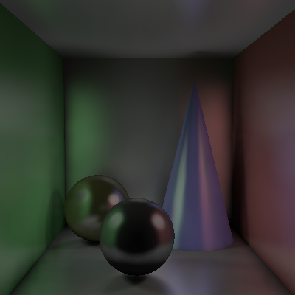
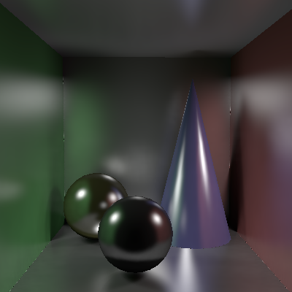
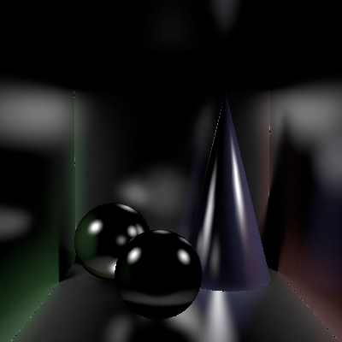
[Davidovič et al. 2010]
Split illumination
Clamping
Global component
Classic VPLs
Compensation
Local component
Local VPLs
indirect illumination
Notes:
We use the idea of separating the light transport into the clamped, global component, and the local component, as previously discussed by Alexander and Miloš.
The global component accounts for the long-distance light transfer, while the local component corresponds to the short-range inter-reflections, and indirect glossy highlights.
We take advantage of the specific structure of each of the two components to design a solution for each of them that is substantially more efficient than a general GI solution.
Specifically, we handle as much energy as possible in the global component which leaves only the local inter-reflections for the local component, which we handle by the so called local VPLs that are distributed by tracing paths from the camera. I will only focus on the local component.

Slide 27
Review of compensation
Kollig & Keller compensation
global
2) Connect
Clamped energy
1) Shoot path
3) Contribute
Notes:
Let us start with the overview of the standard Kollig & Keller [2004] compensation. They first trace a ray from the hit point, and connect the target to global light to obtain the contribution of the path to the pixel. This path tracing result is then used in place of the clamped away energy.
This is a lot of effort for compensating just a single pixel.

Slide 28
Local VPLs – Idea
[Davidovič et al. 2010]
global
Create
local light
local
Contribute
to a tile
Notes:
Our idea is to create a local VPL at the end point of the camera path. This way, the cost of tracing that path is amortized by letting it contribute not just to the pixel that generated the VPL, but also to a tile of its neighboring pixels.
With this basic idea, let us take a closer look at what is necessary to actually make it work.

Slide 29
Local VPLs – Technical solution
[Davidovič et al. 2010]
global
local
local
Probability
density
from
tile pixels
Jitter
tiles
Notes:
The first important thing we have to compute is the probability density of the generated local VPL.
We cannot simply use the probability with which it has been generated, but we have to sum the probabilities over all the pixels in the tile it contributes to. The reason is that all the neighboring pixel could potentially have generated the VPL at this particular location.
The second important thing is that if we used a fixed tile grid, the boundaries would be fairly visible. To break this coherence, we jitter the tiles for each VPLs.

Slide 30
Local VPLs – Technical solution
[Davidovič et al. 2010]
global
local
One-sample
visibility
Key idea: Tile visibility approximation
Notes:
Now we come to the part that would simply not be possible without splitting the light transport.
To compute the full probability density for our light, we would normally need to compute visibility to all pixels, which would be prohibitively expensive.
However, we do have the global component that contains most of the energy and handles most of the shadows.
The local lights can then have their visibility approximated because they only handle local inter-reflections.
We approximate it by just one visibility sample, which is actually the ray that generated the light in the first place.
So the key insight here, the light transport split made tile visibility approximation possible.

Slide 31
The complete local solution
Generate local
lights
Connect to
global lights
Contribute
to a tile
Local solution
(compensation)
Notes:
So, for the overview of the whole process.
We generate local lights
Reject lights with zero contribution
Connect the surviving local lights to global lights
Have them contribute to a tile
And after repeating this about 20 million times, we get the final local solution.

Slide 32
The complete local solution
Global solution
(clamped)
Indirect illumination
solution
Local solution
(compensation)
Notes:
Now we have the result of the local solution. We simply add the result of the global solution and obtain the final indirect illumination solution.
The global solution can be computed by any VPL method, for example Lightcuts. In the original paper we used used a visibility clustering algorithm.

Slide 33
Local VPLs – Results
VSL: 6 min 25 sec
[Davidovič et al.]: 5 min 28 sec
reference: 6360 min
local lights:
17,100,000

Slide 34
Local VPLs – Results
VSL: 6 min 25 sec
[Davidovič et al.]: 5 min 28 sec
reference: 6360 min
local lights:
17,100,000
Notes:
Here we see that the local lights nicely capture this highlight from metal stool leg or the reflection of the paper towel on the metal back wall, something that cannot be done with the “globally distributed” VSLs.

Slide 35
Local VPLs – Limitations
[Davidovič et al.]: 5 min 28 sec
reference: 6360 min
Loss of shadow definition
Small loss of energy
Notes:
However, this scene also shows some of the limitations the method has.
There is a loss of definition of the shadows behind the bottles.
This is caused by the fact that the local lights on the kettle in the front contain too much energy. Pushing more energy into the global component could resolve this problem.
One detail we did not mention is that in some of the scenes we still need slight clamping even on the Local VPLs, causing some darkening here. This can be solved by interpreting the Local VPLs as Local VSLs.

Slide 36
Local VPLs – Conclusions
Good for local inter-reflections
Really useful only when used in conjunction with a separate “global” solution
Notes:
To conclude, distributing VPLs by tracing paths from the camera is very useful for resolving local inter-reflections.
They are best used in conjunction with a separate “global” solution which can take care of the smooth, long distance light transport in the scene.

Slide 37
Thank you

